Slide 1
Unit 1
Advanced cellular mobile communication systems
WEEK 1 : Overview of the legacy 3GPP cellular systems, WiMAX systems: Introduction
WEEK 2 : WiMAX systems: Architecture, Frame structure, Applications
WEEK 3:LTE systems: Introduction, Architecture, Frame structure and applications
These slides contains copyrighted materials from - Andrea Molisch, “Wireless Communication”, Cambridge University Press, 2nd edition, 2013.
Text books, references:
Andrea Molisch, “Wireless Communication”, Cambridge University Press, 2nd edition, 2013.

Slide 2
WEEK 2 LECTURES
WiMAX systems: Architecture, Frame structure, Applications

Slide 3
WiMAX systems
Worldwide Interoperability for Microwave Access (WiMAX) is a wireless communications standard for Metropolitan Area Networks (MANs), e.g., networks covering whole cities or even whole countries.
WiMAX standard was originally intended for data communications; voice is more of an afterthought that is enabled by Voice over Internet Protocol (VoIP) communications. As the emphasis of future cellular systems will lie on data communications, this is beneficial for WiMAX.
The modulation format and multiple-access format of WiMAX, i.e., MIMO/OFDM/OFDMA, is more suitable for high-data-rate communications.
Frequency Bands – 1.9/2.1/2.5/3.5/5 GHz

Slide 4
WiMAX systems: Physical layer
OFDMA PHY. Both Frequency Domain Duplexing (FDD) and Time Domain Duplexing (TDD) are specified, though TDD is by far the more common option. In TDD, the time axis is divided into 5 ms frames, which serve first the downlink (DL) and then the uplink (UL).
In each of the uplink and downlink parts (subframes), OFDM symbols are transmitted, where different subcarriers, and different OFDM symbols, are assigned to different users.
The subcarriers assigned to a user are either distributed over the available bandwidth to achieve high frequency and high-interference diversity, or are all adjacent, so that Adaptive Modulation and Coding (AMC), based on Channel State Information (CSI) at the TX, can be more easily applied.

Slide 5
WiMAX systems: Physical layer
The subcarriers assigned to a user are either distributed over the available bandwidth to achieve high frequency and high-interference diversity, or are all adjacent, so that Adaptive Modulation and Coding (AMC), based on Channel State Information (CSI) at the TX, can be more easily applied.
The subframes are divided into zones, and during each zone, the nature of the assignment of subcarriers to users can be different.
At the beginning of a frame, a notification MAP is sent out, describing which subcarriers are intended for which user. Various types of multiple-antenna techniques can be used for the transmission in both uplink and downlink.
Space–time block codes, spatial multiplexing, as well as antenna selection can be used to increase diversity and data rates

Slide 6
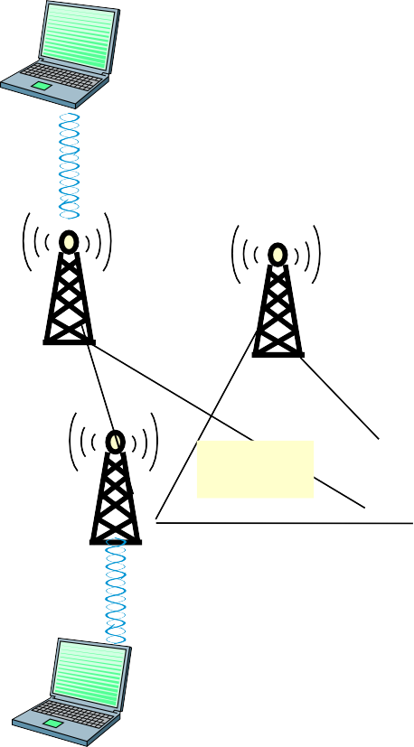
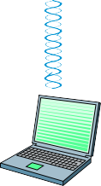



WiMAX System Architecture
CSN: Connectivity Service Network ASN: Access Service Network NSP: Network Service Provider NAP: Network Access Provider
HA: Home Agent, FA: Foreign Agent AAA: Authentication, Authorization and Accounting
Home CSN
Visited CSN
HA
AAA
HA
NSP
ASN
BS
ASN GW (FA)
ASN GW (FA)
BS
NAP
Mesh
BS
BS
BS
BS
MS
P2MP or P2P

Slide 7
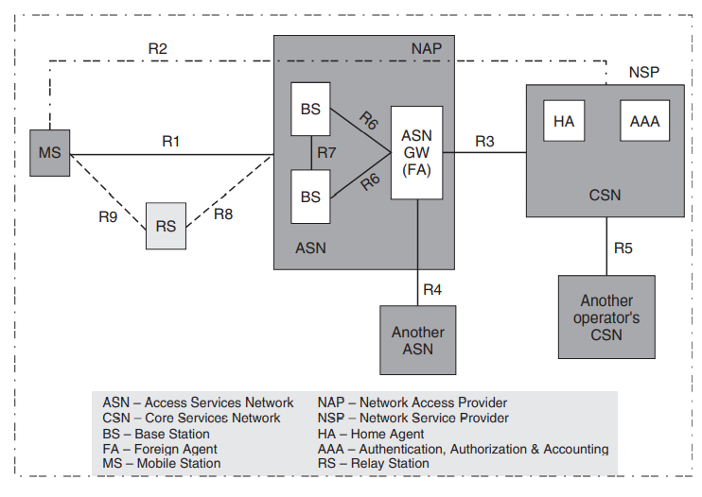
WiMAX systems: Architecture/Network Structure

Slide 8
WiMAX systems: Architecture/Network Structure
A main goal of this architecture is to separate the over-the-air access (the Access Service Network (ASN) from the Internet access (Connectivity Service Network (CSN).
It is a goal that the two networks can be owned by different providers
The ASN provides the over-the-air connectivity corresponding to the PHY and MAC layer as defined in the IEEE 802.16 standard, and provides scheduling and resource management.
It discovers which networks are available and connects the user to the preferred (permissible) CSN.

Slide 9
WiMAX systems: Architecture/Network Structure
Each BS is connected to an ASN Gateway, which has somewhat similar functionality as the BS controller in GSM
WiMAX defines a number of different functional splits between BS and Gateway. During network discovery, the Mobile Station (MS) discovers both the access service provider (which is characterized by a unique 24-bit “operator ID” in the DL-MAP) and the available Network Service Provider (NSP).
The situation is similar to WiFi, where an access point just provides a wireless link that can be seen as a “cable replacement” for a wired Internet connection; getting access and making payments to the Internet service provider is independent of this operation.

Slide 10
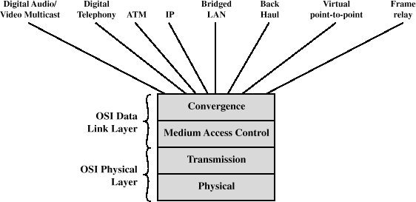
IEEE 802.16 Protocol Architecture

Slide 11
Protocol Architecture
Physical layer functions:
Encoding/decoding of signals
Preamble generation/removal
Bit transmission/reception
Medium access control layer functions:
On transmission, assemble data into a frame with address and error detection fields
On reception, disassemble frame, and perform address recognition and error detection
Govern access to the wireless transmission medium

Slide 12
Protocol Architecture
Convergence layer functions:
Encapsulate PDU framing of upper layers into native 802.16 MAC/PHY frames
Map upper layer’s addresses into
802.16 addresses
Translate upper layer QoS parameters into native 802.16 MAC format
Adapt time dependencies of upper layer traffic into equivalent MAC service

Slide 13
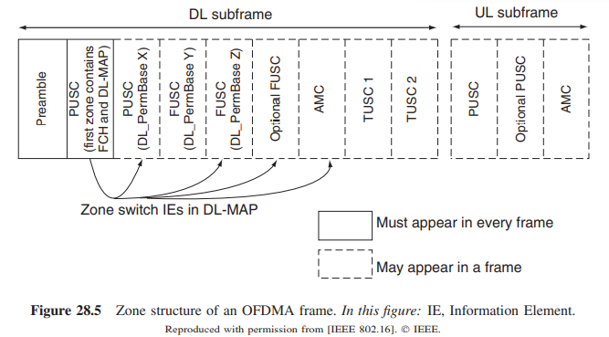
WiMAX frame structure and zones
The largest fundamental unit in the time–frequency plane is a frame, which is 5-ms long and encompasses all subcarriers.
Frame is divided into subframes that describe the time (in the TDD mode) for uplink and downlink.
Each subframe is divided into permutation zones, during which one particular subcarrier permutation is used. Figure shows the subdivision of frames into subframes and permutation zones.

Slide 14
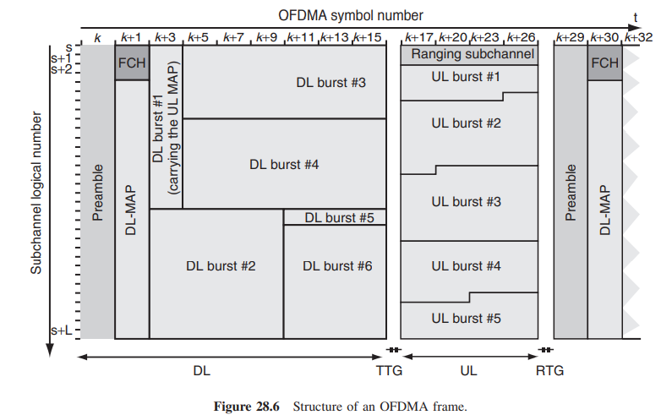
Figure 28.6 shows the detailed frame structure (with only the mandatory zones). each zone contains user data. It is important to know that the contiguous arrangement of the data in the time–frequency plane describes logical subchannels.

Slide 15
WiMAX frame structure and zones
A user might occupy logical channels 5 and 6; but those logical subchannels might be mapped to widely distributed (in the time–frequency plane) physical subcarriers, due to the subcarrier permutation. In addition to the data bursts for the separate users, a frame contains preambles and control signaling (DL and UL-MAP, Frame Control Header (FCH)).
The FCH is strongly protected: it is sent with Quadrature-Phase Shift Keying (QPSK) modulation with rate 1/2 convolutional code, and in addition repeated 4 times; the FCH information is sent on 4 subchannels with successive logical subchannel numbers.
The FCH contains the DL frame prefix (which state which subchannels are used for the DL-MAP), and other details about the DL-MAP (length of the MAP, use of repetition coding, etc.).
It is always sent on the lowest numbered subchannels after the DL frame preamble.
After the FCH, the DL-MAP and the UL-MAP are sent. They specify which data regions (OFDM symbols and subchannels) are being assigned to which user for uplink and downlink; note that the MAPs may be compressed.

Slide 16
WiMAX frame structure and zones
In order to distinguish between subcarriers and subchannels, A subchannel is a logical unit of data, which is mapped onto a collection of physical subcarriers (not necessarily contiguous);
Exact number and arrangement of the subcarriers is defined as the subcarrier permutation (note that there are several different subcarrier permutation modes, Partial Use of SubCarriers (PUSC), Full Usage of SubCarriers (FUSC), and Adaptive Modulation and Coding (AMC).
A contiguous (in time and/or frequency) set of subchannels is known as a data region, and is always transmitted using the same burst profile (modulation format, code rate, type of code).
The smallest possible data allocation unit is called a slot. The size of a slot is defined in units of subchannels (in the frequency domain) and OFDM symbols (in the time domain).
The numerical values for the size of a slot depend on the subcarrier permutation as well as on uplink/downlink;
Each user is assigned one or multiple slots for communicating its data. The details of which slots are associated with each user are communicated in the DL-MAP and UL-MAP fields.

Slide 17
WiMAX Supported Applications
Typical applications/services
Broadband Internet access
Real time applications
Video streaming
VoIP, Video on Demand
Telemedicine application/Video Conference
Surveillance and monitoring (forests, volcano, etc.)
Other possible real time complex applications:
E-learning
General applications and services based on IP conectivity
Application types
Legacy ( no direct signalling capabilities for QoS)
Need an agent to help them
Signalling capable: e.g. SIP based
Possible direct interaction with control plane for QoS reservation

Slide 18


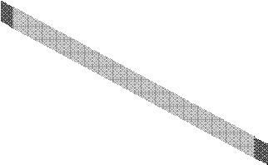





















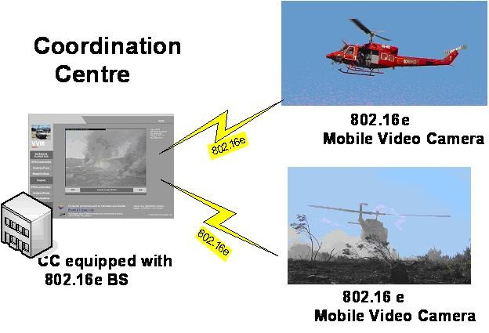
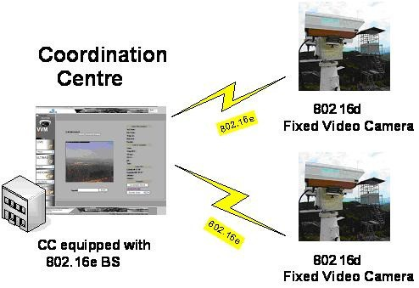
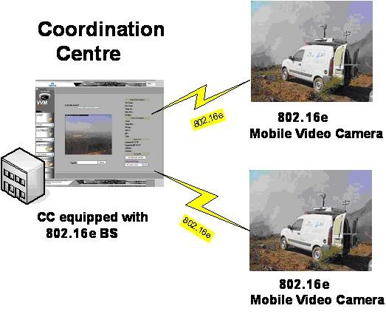

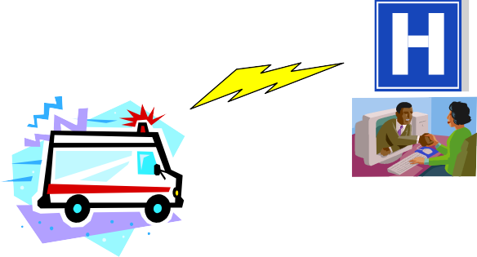
WiMAX Supported Applications- examples
Environmental Monitoring: Volcano Monitoring
Impervious Area (Mobile WiMAX)
User Movement Mobile WiMAX Terminal Sensors
 | 802.16e
WiMAX
Backhaul
802.16d
Monitoring Centre
Telemedicine: Remote Assistance
Patient Location Hospital
Fire Prevention: Video Surveillance
VoIP , data, image and video streaming
Pics - CTRQ Conference June 29 - July 5, 2008 - Bucharest, Romania

